Slide 1



APPLICATION PROGRAMMING INTERFACE

Slide 2
In computer programming, an Application Programming Interface (API) is a set of routine definitions, protocols, and tools for building software and applications. A good API makes it easier to develop a program by providing all the building blocks, which are then put together by the programmer.
An API uses regular programming languages (e.g. Python) but also provides a development environment with useful functions that help us make games, applications, websites and applications.

Slide 3
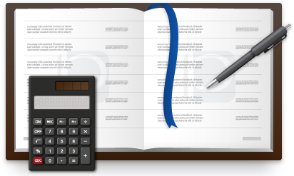
IDE vs API
Think about a student doing accounts. A programming language is the balance sheet / accounts that the accounts student prepares. An API is the journal or ledger that accounts students use to write their accounts. The ledger / journal has special lines / margins that make it easier for the student to produce their accounts as opposed to using

Slide 4


Slide 5
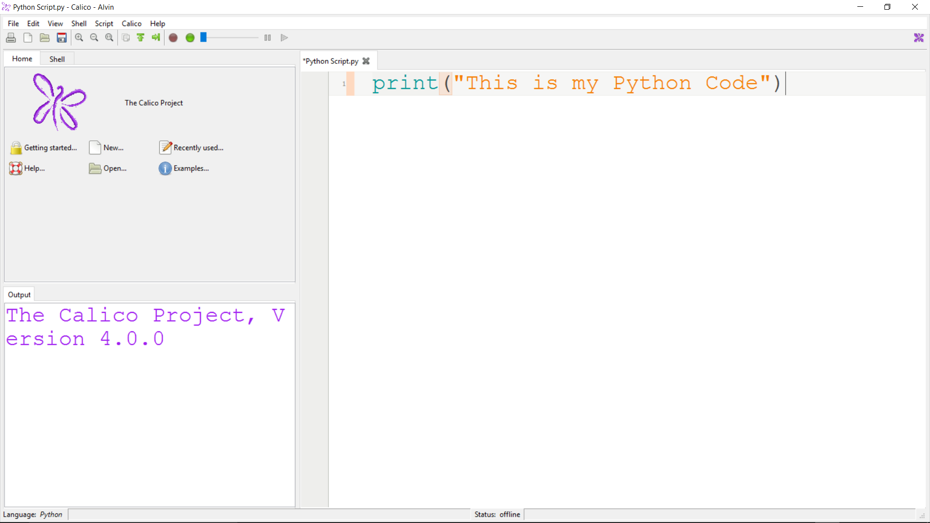
Notes:
I type my code in the script on the right hand side

Slide 6

CLICK “RUN” TO EXECUTE
Notes:
I run the code by clicking the green button “Run”

Slide 7
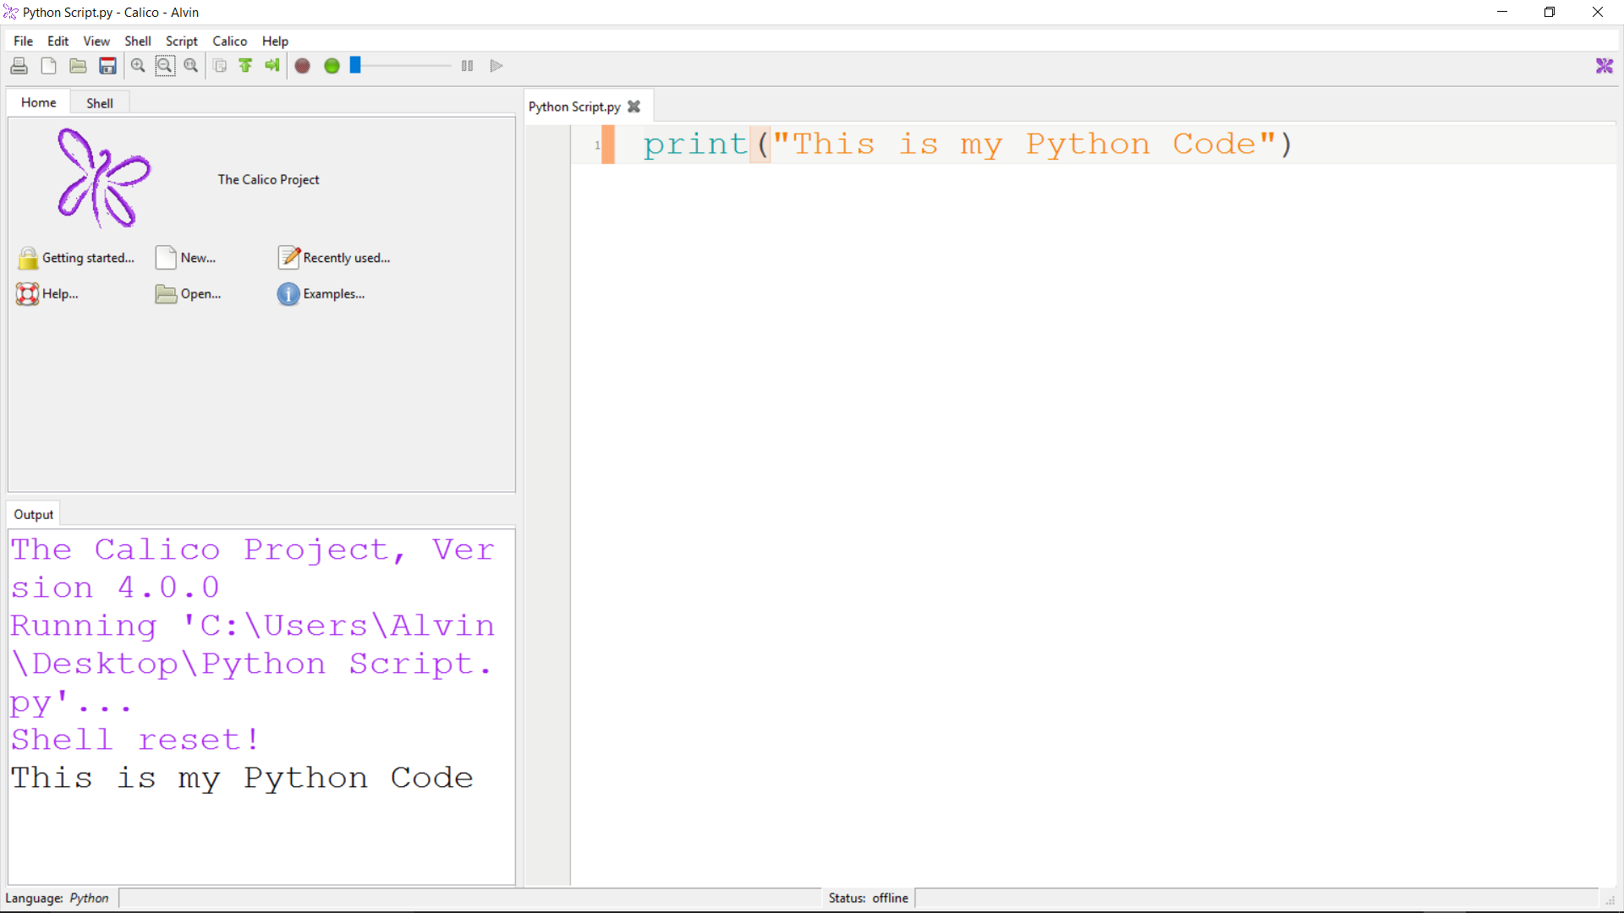
OUTPUT WINDOW
Notes:
The output is printed on the Output window on the bottom left corner

Slide 8
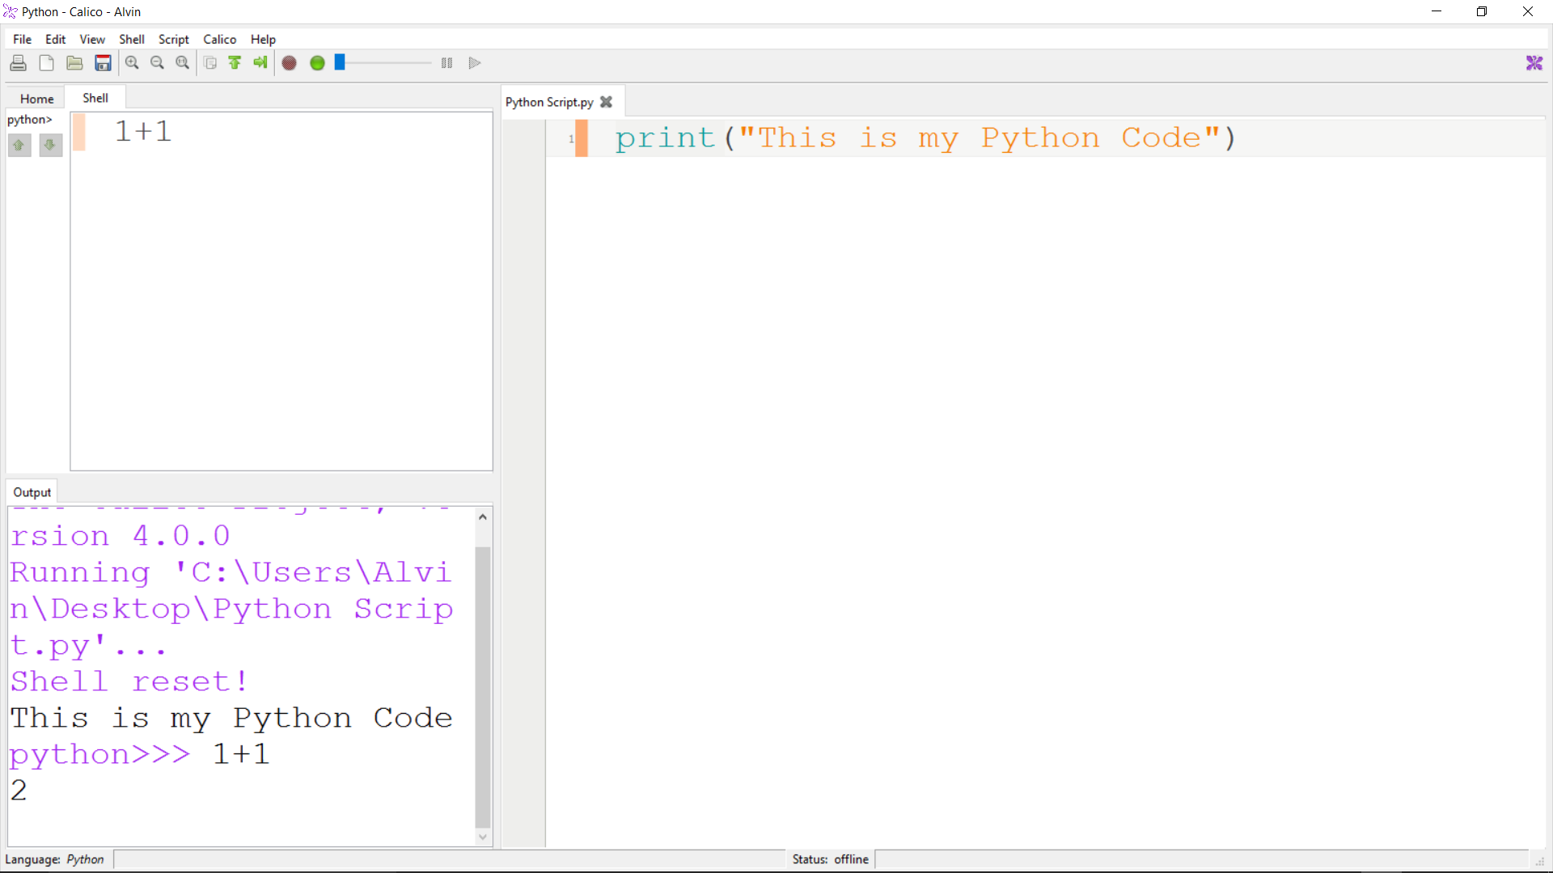
SHELL
SCRIPT
OUTPUT FROM THE SCRIPT & SHELL
Notes:
There is a script, a shell and the output window

Slide 9

BUILT-IN EXAMPLES IN CALICO
EXAMPLES > PYTHON >
GRAPHICS > ANIMATIONS GAMES > ANGRYBLOCKS
GRAPHICS > ANIMATIONS GAMES > PONG
MUSIC > DRUMS
AI > CHESS
Notes:
Go through the different examples in Calico

Slide 10
BUILT-IN CALICO FUNCTIONS
http://web1.cs.brynmawr.edu/Calico_Processing_Reference#background-red-green-blue-alpha

Slide 11
Meaning of RGB
RGB means Red Blue Green, is a color-scale given on a scale of 1 to 255.
It describes ALL colors by the amount of Red, Blue and Green in them.
pure Red – rgb(255,0,0) pure Green – rgb(0,255,0)
pure Blue – rgb(0,0,255)
White – rgb(255,255,255) Black – rgb(0,0,0)
Pink – rgb(255,192,203)
Notes:
Give a basic explanation of the RGB color scale: -
Color can be expressed as a specific combination of amounts of Red, Green and Blue
Computers express the amounts on a scale of 0 to 255

Slide 12

EXERCISE 1
Create a window of width 1020p and height 720p
Draw the French Flag

Slide 13

EXERCISE 2
Create a window of width 1020p and height 720p
Draw the Japanese Flag

Slide 14

EXERCISE 3
Create a window of width 1020p and height 700p
Draw the Zimbabwean Flag (exclude the Bird…..for now)

Slide 15

EXERCISE 4
Create a window of width 1020p and height 720p
Draw the Swedish Flag. Write “Sweden” below the flag.

Slide 16
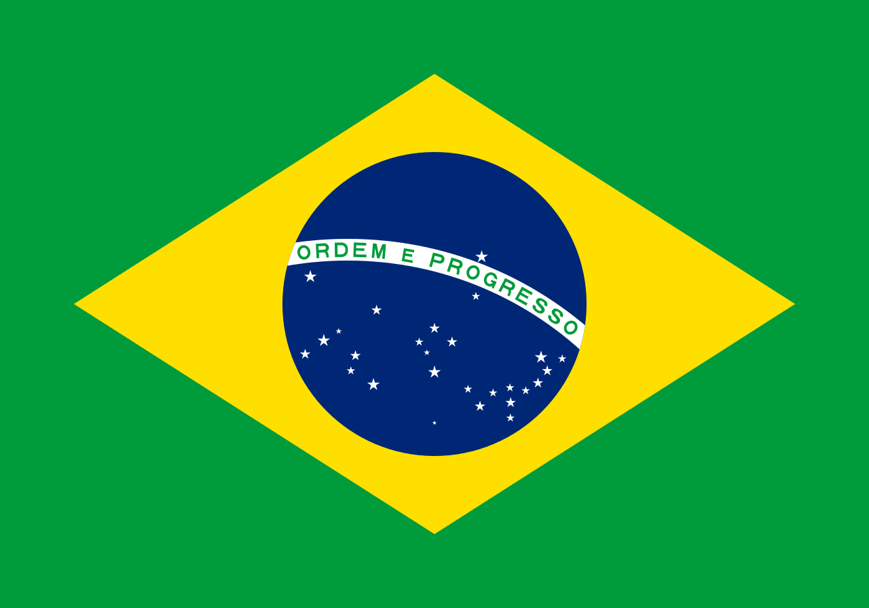
EXERCISE 5
Create a window of width 1020p and height 720p
Draw the Brazilian Flag. Write “Brazil” below the flag.

